Slide 1
PBIS Tier II Establishing a System of Targeted Behavioral Support

Slide 2
Behavior Expectations
Be Respectful
Be Responsible
Be a Problem Solver

Slide 3
Behavior Expectations Matrix
Be Respectful | Be Responsible | Be a Problem Solver
Complete sign-in and other team tasks on time Set cell phones to vibrate/silent mode Keep your phone with you at all times Accept calls in hallways only ☑ Be on time | Clean up your table area at the end of the program and discard trash Take care of personal needs Contact a consultant so that we can provide any needed assistance. | Seek clarification (Ask questions) Participate in discussions Use positive statements and restatements

Slide 4
Ohio PBIS Network

Slide 5
Outcomes
Identify key features of Tier II
Learn how Tier II behavioral supports fit within a PBIS framework
Use data to determine your building’s readiness for Tier II development

Slide 6
Purpose & Key Features of Tier II
Use data to identify students who are at-risk for or currently experiencing emotional and/or behavioral difficulties.
Prevent the development or decrease the frequency and/or intensity of students’ problem behaviors.
Provide standardized interventions that effectively and efficiently support students

Slide 7
Common Characteristics of Students Needing Tier II Supports
Behavioral Challenges:
Non-compliance
Aggression
Self-management
Social competence
Academic skill deficits

Slide 8
Tier II Interventions
Designed to teach a new skill, build fluency or encourage generalization
Created for “at risk” children struggling with expectations
Uses evidence-based practices
Monitors data regularly
Targets large group instruction
(Inadequate for chronic and serious behaviors)

Slide 9
Tier II Interventions
Designed to teach a new skill, build fluency in a skill, or encourage application of existing skills to a new situation.

Slide 10
Interventions for students who are:
“At-risk”
Struggling with expectations
Exhibiting problem behaviors across multiple settings
In need of re-teaching of specific skills and/or expectations

Slide 11
Tier II Interventions
Typical Interventions:
Targeted Environmental or Academic Interventions (Classroom)
Check In/Check Out
Small Group Social Skills
Mentoring
A Brief Functional Behavioral Assessment may help identify a preferred intervention

Slide 12
What does Tier II look like?

Slide 13
Tier II
Small groups of students with relatively homogenous behavior (skipping class, bus referrals) which may be specific
Students are expected to have a reasonable response to intervention

Slide 14
What Makes Something a Targeted Intervention?

Slide 15
Targeted Interventions
Matches the school’s data determined needs.
Should be able to be implemented within 3-5 days
Staff trained in the intervention
Materials are on hand
Function-based
Data collected to monitor outcomes
Formal system exists for informing parents/family of progress

Slide 16
How are students selected for Tier II interventions?
Office referrals (ex: 3-5 major infractions)
Nominated by a staff or family to participate
ODRs might NOT be helpful identifying ALL students that need additional support……teachers and support staff may recommend a student based on observation and knowledge of the student

Slide 17
Tier 2 Data Decision Rules Consider Multiple Sources of Data (Behavior & Academic)
Office Discipline Referrals (ODR”s) (ie: Student has ___ODR’s)
Minor Classroom Reports (ie: Student has ___ consecutive minor reports)
Attendance (ie: Student misses more than ___days)
Academic progress /progress
Incomplete classwork/homework
Time out of instruction (ie: Student experiences more than __ minutes out of instruction)
Social-Emotional Learning (ie: internalizing behaviors) such as: frequent requests/visits to clinic, counselor, administrator, etc.
Screening tools
Teacher/staff/family/student nominations
17

Slide 18
Who?
Number of Referrals per Student
Tier II Targeted
Tier 1 Universal
Tier 3 Intensive

Slide 19
Why Office Discipline Referrals May Not Be Enough

Slide 20
Office Discipline Referrals
May miss students in settings with persistent or violent behavior who may not generate office referrals
May not identify students with severe “internalizing” behaviors
May not identify students with many “minors” but few “majors”
May not reflect that some teachers refer and some don’t
Kincaid, Childs, & Putnam, October, 2007

Slide 21
How is a particular Tier II intervention selected for an individual student?

Slide 22
Tier II Interventions
Sample Quick Sort Matrix: List the targeted interventions that are available in your school, identify the possible functions that each intervention delivers by putting a checkmark in the cell of the matrix.
 | Targeted Interventions
Intervention Function | Check In/Check Out (CICO) | Check In/Check Out (CICO) | Social Skills Club | School-based Mentor | Home/School Behavior Plan | Lunch Buddies | Contracts
 | Increases opportunities for positive adult attention. | ✓ | ✓ | ✓ | ✓ | ✓
 | Increases opportunities for positive peer attention . |  | ✓ |  |  | ✓
 | Provides access to choice for alternatives / activities. |  |  |  | ✓ |  | ✓
 | Addresses specific social skills instruction on how to relate with others in the school setting, | ✓ | ✓ |  | ✓ | ✓
 | Promotes a positive and encouraging relationship with an adult. | ✓ |  | ✓
 | Increases number of pre-correction prompts and structure for “what to do” throughout the day. | ✓ |  | ✓ | ✓
 | Increases opportunities for stronger incentives/positive reinforcement. | ✓ |  |  | ✓ |  | ✓
 | Creates a home-and-school communication system. | ✓ |  |  | ✓ |  | ✓
 | Increases consistency in behavior expectations between home and school. |  |  |  | ✓ |  | ✓

Slide 23
Tier II Implementation
1
Create process for identifying students in need of Tier II supports.
Create several interventions that address various needs of students.
2

Slide 24
Tier II Implementation
3
Allocate resources to implement the interventions.
Sort students into the tier II interventions.
4

Slide 25
Tier II Implementation
5
Collect data on progress of students receiving interventions.
Evaluate success and modify program.
6

Slide 26
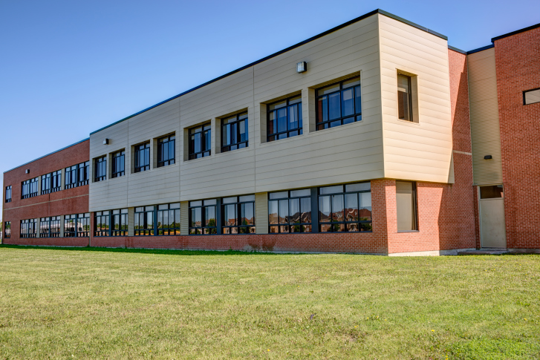
Key Features of Tier II Intervention: Needs Based Instruction
NOT A PERSON OR A PLACE

Slide 27
Communication with Family
Parents/Guardians should be aware of Tier I supports
Open House, Family Nights, Conferences, Newsletters, Home Activities

Slide 28
Communication with Family
Parents/Guardians must be involved in Tier II supports
Informed of need and participation in Tier II
Update on progress
Parent reinforcement and support of effort

Slide 29
Selecting Tier II Interventions
Matching the student’s need to the intervention should be based on the function (purpose and reason) of the behavior.
Targeted environmental interventions should be built upon the universal system. (Classroom and school-wide)
Targeted interventions should be tried first before moving to individualized practices.

Slide 30
Tier II Interventions
Check in-Check out
Social and Academic Instructional Groups
School-based Mentors

Slide 31
Before selecting an intervention…
Check your classroom management strategies

Slide 32
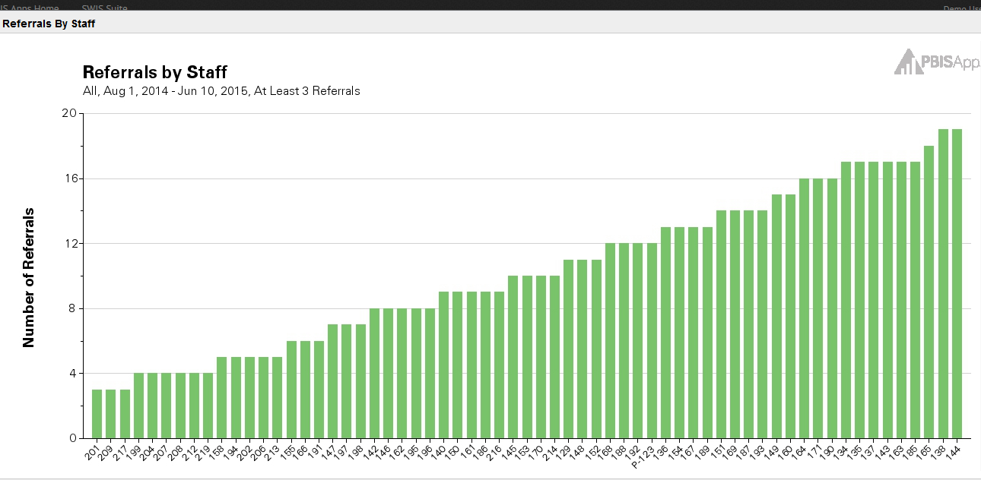
Increase Classroom
Management Support

Slide 33
Increase Classroom
Management support
Staff should check to see if these strategies are in place.
Classroom-wide positive expectations are taught and encouraged.
Classroom routines and cues are taught.
A ratio of 4 positives to 1 corrective adult-student interaction is practiced consistently.
Active supervision occurs in the classroom and during transitions.
Redirections for minor, infrequent behavior errors are used consistently.
Frequent pre-corrects for chronic errors are used.
There is effective academic instruction and curriculum.
There is a continuum of appropriate consequences enforced consistently and fairly.

Slide 34
PBIS
When a student struggles to read…… we teach.
When a student struggles in math…… we teach.
When a student struggles to play an instrument…… we teach.
When a student struggles to behave……. we punish?

Slide 35
Discipline Works When...
prevention creates more positive than negative consequences
4:1
Reinforcement
(success)
Punishment

Slide 36
Paradigm Shift
REACTING to
Problem Behavior
Teaching and Recognizing
Positive Behaviors

Slide 37
Tier II Intervention
The Behavior Education Program (BEP)
A Daily Check-in/Check-out Intervention (CICO)
Crone, Hawken, & Horner, 2010
The Guilford Press

Slide 39
Cycle: Check-In and Check-out
1. Morning check-in
(Get Daily Progress Report-DPR)
2. Teacher/staff feedback throughout day
3. End of day check-out
Tally and record points
Receive recognition

Slide 40
Cycle: Check-In and Check-out
4. Data collection and progress monitoring
5. Take DPR home and return signed copy

Slide 41
HAWK Report Helping A Winning Kid Date _________________ Teacher___________________________ Student_____________________________
0 = No 1= Good 2= Excellent | Be Safe | Be Respectful | Be Your Personal Best |  | Teacher initials
 | Keep hands, feet, and objects to self | Use kind words and actions | Follow directions | Working in class
Class | 0 1 2 | 0 1 2 | 0 1 2 | 0 1 2
Recess | 0 1 2 | 0 1 2 | 0 1 2
Class | 0 1 2 | 0 1 2 | 0 1 2 | 0 1 2
Lunch | 0 1 2 | 0 1 2 | 0 1 2
Class | 0 1 2 | 0 1 2 | 0 1 2 | 0 1 2
Recess | 0 1 2 | 0 1 2 | 0 1 2
Class | 0 1 2 | 0 1 2 | 0 1 2 | 0 1 2
Total Points = Points Possible = 50 |  | Today ______________% |  | Goal ______________%
Parent’s signature______________________________
WOW:_________________________________________________________________________________

Slide 42
Which Students Will Benefit?
APPROPRIATE
Students that:
Continue to display problems after universal school-wide/Tier 1 supports are in place, but don’t require immediate individualized support
Demonstrate behavior patterns across multiple settings
Are in the 2-5 office referrals/infractions range per month
Display low level disruptions
Talking out, Unprepared, Talking back, Non-compliant, and/or other minor infractions
Seek adult attention
Are willing to participate
INAPPROPRIATE
Students that:
Demonstrate serious or violent behaviors/infractions
Demonstrate extreme chronic behavior (6-10 or more referrals)
Require more individualized support
Students with more intense problems may benefit, but will need additional supports!

Slide 43
Who Do We Need?
1
Coordinator
2
Facilitators

Slide 44
Coordinator vs. Facilitator
Coordinator
Facilitator
Organizes and/or oversees the specific interventions such as CICO, S/AIG & Group with Individual Features
Manages resources
May have limited contact with students
Roles include: scheduling meetings, review & collect data to share during team meetings, etc…
Directly provides intervention support services to youth/families
May typically serve as many as 10-15 children
Roles include: Provide daily check-in and check-out with students
Run groups
Maintain student records & data

Slide 45
Recommended Roster Limits
No more than 30 students per facilitator at the secondary level
middle, junior high, high school
Approximate maximum 15-20 students per facilitator at the elementary level.
(See Crone, Hawken, & Horner, 2010, p. 92)

Slide 46
How does Check-In/Check-out improve behavior?

Slide 47
Check-in/Check-out provides …
Explicit teaching of expected behavior to the student
Structured prompts for appropriate behavior
Opportunities to practice skills
Opportunities for positive feedback
Strategies for fading support as the student gains new skills
A system for communicating with parents
Regular data for monitoring student progress

Slide 48
Check-In/Check-Out
Research supported practice
Decreases problem behavior
Effective for 60-75% of Tier II, at-risk students
Schools can successfully implement
Less effective for students who do not find adult attention reinforcing

Slide 49
Steps for Implementation
1. Determine how Check-in/Check-out will be implemented in your school
2. Develop Daily Progress Report and Progress Summary
3. Develop reinforcement system for students on Check-in/Check-out
4. Develop criteria for qualifying for CICO and referral system

Slide 50
Steps for Implementation
5. Create system for managing daily data
6. Plan for fading students off intervention
7. Develop staff training
8. Develop student and parent training

Slide 51
3-Tiered System of Support
Necessary Conversations (Teams)
Universal Team
Secondary Systems Team
Problem Solving Team
Tertiary Systems Team
Plans SW & Class-wide supports
Uses Process data; determines overall intervention effectiveness
Standing team; uses FBA/BIP process for one youth at a time
Uses Process data; determines overall intervention effectiveness
Universal Support
CICO
Brief
FBA/BIP
SAIG
Complex
FBA/BIP
WRAP
Group w. individual
feature
Brief FBA/BIP
Sept. 1, 2009
Notes:
51
51

Slide 52
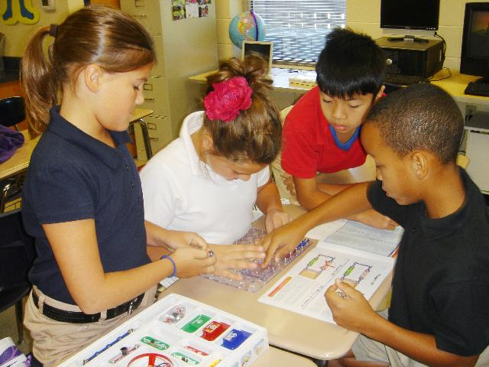
Tier II Intervention
Social and Academic Instructional Groups

Slide 53
What Does It Look Like?
Social Academic Instructional Groups (SAIG) are designed to teach students appropriate behaviors that will help them be successful.
Students that participate in this program are identified by daily progress monitoring (DPR) data as needing extra behavior support.
These students have been in CICO and still need more assistance.
Office discipline referrals (ODRs) give team members ideas of what behaviors need to be targeted (i.e. fighting, disrespect, leaving the room without permission, etc…).

Slide 54
What Does It Look Like?
Once the target behavior is identified, the SAIG Group facilitator creates lesson plans that will teach skills to help students become more successful.
Ex: if the target behavior is fighting, the lesson plan will teach problem-solving skills or anger management.
Ex: leaving the room without permission, the SAIG lesson plan will teach ways to cope inside the classroom, rather than leaving (i.e. safety zone techniques).

Slide 55
Describe the skill being taught
Model non-examples
Practice the skill being taught (role play)

Slide 56
Any staff/teacher can lead these groups because they occur during lunch times.
Groups should run a consistent schedule every week so that any one student can be added at any time.
Once the Check-in/Check-out facilitator recommends a student for SAIG groups, the student is automatically placed in the appropriate group.

Slide 57
Social/Academic Instructional Groups
3 types of skill-building groups:
Pro-Social skills
Problem-solving skills
Academic Behavior skills
Best if involves use of a DPR
Notes:
57
57

Slide 58
Skill Group Facilitators
Social Workers
Psychologists
Counselors

Slide 59
Social/Academic Instructional Groups
Selection into groups should be based on youths’ reaction to life circumstance not existence of life circumstances (ex. fighting with peers, not family divorce)
Skills taught are common across youth in same group (ex. use your words)
Notes:
59
59

Slide 60
Social/Academic Instructional Groups
Data should measure if skills are being USED in natural settings, not in counseling sessions (transference of skills to classroom, café etc.)
Stakeholders (teachers, family etc.) should have input into success of intervention (ex. Daily Progress Report)
Notes:
60
60

Slide 61
Choosing or Designing Group Interventions
Choose and modify lessons from pre-packaged material based on the skill needed for the group
Use already created universal behavior lesson plans or create lesson plans to directly teach replacement behaviors
And/or

Slide 62
Template Considerations
Name/Type of group
Pro-social skills
Problem-solving skills
Academic Behavior skills
Skill sets and purpose of group
Identify skills that need to be taught
Culturally appropriate Behavior Lesson Plans/Curriculum that addresses skill set

Slide 63
Preparation Phase
Identify Common Deficits
Gather Lessons
Plan for Generalization & Maintenance
Establish Session Procedures

Slide 64
Create Your Own Lesson Plans: Teaching Behavioral Expectations
EXTENDED VERSION:
1) State behavioral expectations
2) Specify observable student behaviors (rules)
3) Model appropriate student behaviors
4) Students practice appropriate behaviors
5) Reinforce appropriate behaviors
Notes:
64

Slide 65
Steps of a Behavioral Lesson Plan
1) Explain expectations & why need
2) Check for student understanding/buy-in
3) Model examples
4) Check for student understanding/buy-in
5) Model non-examples

Slide 66
Steps of a Behavioral Lesson Plan
6) Check for student understanding/buy-in
7) Model examples
Students practice
Teacher reinforces student

Slide 67
Examples of Packaged Instructional Groups
Second Step (Grades PreK-8)
(ex: http://www.cfchildren.org/)
Thinking, Feeling, Behaving (Grades 1-12)
https://www.researchpress.com/books/846/thinking-feeling-behaving
http://www.therapeuticresources.com/21281text.html
Tough Kids Social Skills (Grades 3-7)
http://toughkid.com/series.html
Walker Social Skills Curriculum (Grades 6-12)
http://nichcy.org/wp-content/uploads/docs/eesocialskills.pdf
http://www.school-connect.net/?gclid=CL6k9eKBrbcCFYtDMgod6goABw
Skillstreaming (Grades PreK-12)
http://www.skillstreaming.com/
All of above examples could be used to develop universal behavior lesson plans.

Slide 68
Examples of Packaged Instructional Groups
Stop & Think Social Skills (Grades PreK-8)
http://www.soprislearning.com/school-climate/stop-think-social-skills-program
Passport (Grades 1-12)
http://www.kidsmatter.edu.au/primary/programs/passport-program
I Can problem Solve (Grades PreK-6)
http://www.californiahealthykids.org/product/S90
http://smhp.psych.ucla.edu/qf/behaviorprob_qt/buildingonbest.pdf
Aggression Replacement Training
http://www.aggressionreplacementtraining.com/
All of above examples could be used to develop universal behavior lesson plans.

Slide 69
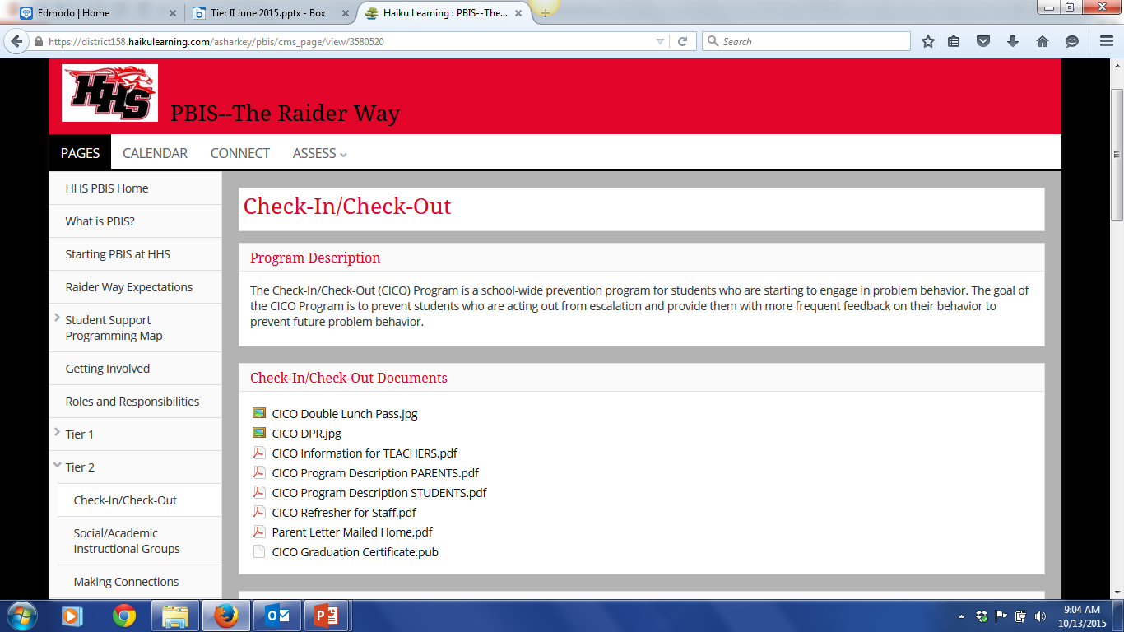
http://district158.haikulearning.com/asharkey/pbis/cms_page/view/3581026

Slide 70
Three Keys to Successful Social/Academic Instructional Groups

Slide 71
Have a Roadmap/Template

Slide 72
Curriculum
Pay attention to use of a packaged curriculum rather than existing universal behavior lesson plans.

Slide 73
Build Social/Academic Instructional Groups on top of a strong universal curriculum

Slide 74
Procedural Considerations
Welcome
Introductions, if necessary
Purpose of Group
Group Norms – ie. expectations of group, aligned to school-wide expectations
“Curriculum” with practice
Closing
Reflection
Application
Goal setting Corey & Corey, 2006

Slide 75
Academic Behavioral Skills
From Skill Streaming
Listening
Asking for Help
Saying Thank You
Bringing Materials to Class
Following Instructions
Completing Assignments
Contributing to Discussions
Offering Help to an Adult
Asking a Question
Ignoring Distractions
Making Corrections
Deciding on Something to Do
Setting a Goal
From Getting Organized Without Losing It
Homework Checklist
After School Scheduler
9 Great Reasons to Use a Student Planner

Slide 76
Pro-Social Skills and Friendship
From Skill Streaming
Introducing Yourself
Beginning a Conversation
Ending a Conversation
Joining In
Playing a Game
Asking a Favor
Offering Help to a Classmate
Giving a Compliment
Accepting a Compliment
Suggesting an Activity
Sharing
Apologizing
From Strong Kids (Grades 3-5)
About My Feelings
Ways of Showing Feelings

Slide 77
Problem-Solving Skills
From Skill Streaming
Knowing Your Feelings
Expressing Your Feelings
Recognizing Another's Feelings
Showing Understanding of Another's Feelings
Expressing Concern for Another
Dealing with Your Anger
Dealing with Another's Anger
Expressing Affection
Dealing with Fear
Rewarding Yourself
Using Self-Control
Asking Permission
Responding to Teasing
Avoiding Trouble
Staying Out of Fights
Problem Solving
Accepting Consequences
Dealing with an Accusation
Negotiating
From The Peace Curriculum
Using Positive Self-Talk to Control Anger
Homework #3 Anger Control: Consequences for Your Actions
Keeping Out of Fights

Slide 78
Ex DPR card of MS student in S/AIG
Example Daily Progress Report
NAME:______________________ DATE:__________________
Teachers please indicate YES (2), SO-SO (1), or NO (0) regarding the student’s achievement to the following goals.
EXPECTATIONS | 1 st block | 2 nd block | 3 rd block | 4 th block
Be Safe Use your words Use deep breathing | 2 1 0 | 2 1 0 | 2 1 0 | 2 1 0
Be Respectful Keep arm’s distance Use #2 voice level when upset | 2 1 0 | 2 1 0 | 2 1 0 | 2 1 0
Be Responsible Ask for breaks Self-monitor with DPR | 2 1 0 | 2 1 0 | 2 1 0 | 2 1 0
Total Points
Teacher Initials
Adapted from Grant Middle School STAR CLUB
3 school wide expectations
skill set being taught in the SAIG
Adapted from Responding to Problem Behavior in Schools: The Behavior Education Program by Crone, Horner, and Hawken

Slide 79
Example Manuals

Slide 80
Other Social Skills Programs
Lunch bunch
Second Step Social Skills Program
Social stories

Slide 81
Implementation Phase
Notify Participants
Teach Skill Lessons
Monitor Progress
Evaluate Outcomes

Slide 82
Discussion
Do you have students who could benefit from social/academic skills groups? Which students? What are the areas of concern?
Is your school already implementing social skills groups? Are they effective? How do you know?
What steps might you take to investigate programs that could benefit your students?
Be prepared to share out

Slide 83
Tier II Intervention
Check and Connect A Student Engagement Intervention
University of Minnesota
Institute on Community Integration

Slide 84
What is Check and Connect?

Slide 85
Check and Connect
Check & Connect is an intervention used with K-12 students who shows warning signs of disengagement with school and who are at risk of dropping out.

Slide 86
Check and Connect
Descriptive Characteristics
Targeted (Tier II) or intensive (Tier III) intervention
A structured mentoring intervention
Empirically supported
Clearly delineated elements

Slide 87
Check and Connect
Four components =
A mentor who works with students and families for a minimum of 2 years
Regular “checks” using school data
Timely and individualized intervention “connect”
Engagement with families

Slide 88
What is Check and Connect?

Slide 89
Core Elements of Check and Connect
Relationships
Problem Solving
and Capacity Building
Persistence-Plus

Slide 90
Relationships
Focus on alterable variables
Participation in and affiliation with school
Problem Solving
& Capacity Building
Cognitive-behavioral approach
Persistence-Plus
Persistent source of motivation
Consistent message that education is important
Personalized, data-based intervention
Long-term commitment
Acquisition of skills
Diminish dependency on mentor
Familiarity with student and his/her family (continuity)
Coping Skills
Search for solutions rather than blame
Resolve conflict constructively

Slide 91
Resources Needed
Coordinator
Mentor 1
Student A
Student B
Mentor 2
Student C
Student D
Mentor 3
Student E
Student F

Slide 92
Resources
Institute on Community Integration
University of Minnesota
http://ici.umn.edu/checkandconnect
Publications = Check & Connect: A comprehensive student engagement intervention (manual; cost is $50)

Slide 93
Other Mentoring Programs
Good Friends Intervention
Group Mentoring
Team Mentoring
Peer Mentoring
http://educationnorthwest.org/sites/default/files/building-effective-peer-mentoring-programs-intro-guide.pdf
E-Mentoring

Slide 94
Discussion
Do you have students who could benefit from mentoring? Which students?
What steps might you take to implement Check & Connect or other mentoring programs?
What other considerations do you have?
Be prepared to share out

Slide 95
Examples

Slide 96
More Examples
Newcomers Club
A process that ensures that new students to the school receive an orientation to the school’s entire PBIS program in a timely manner

Slide 97
More Examples
Homework Club
Students remain after school (everyday 1/2 hour) or 1 day per week (1-2 hours) to complete work. Students are paired up with “reminder” buddies who check in on work completion. Provide monitoring of completion and incentives for meeting goals

Slide 98
More Examples
Contracts
A simple arrangement that ties student behavior to a long-term reward or incentive

Slide 99
More Examples
Increased Academic Support
Could include modified instruction, increased practice on basic skills, assistance w/organization, peer support, tutoring, homework assistance

Slide 100
More Examples
Alternatives to Suspension
Restitution, social restitution (making amends), think sheets, time-out (criteria/ procedures should be clearly defined), buddy room

Slide 101
More Examples
Simple Behavior Plan-function based
May be developed by student and teacher involving a single intervention or change to a student’s program

Slide 102
Develop Data Decision Rules for Student Response to Intervention

Slide 103
Monitor Student Progress and Evaluate Process
Original data sources that lead to student identification
ODR
Attendance
Academics
“time out of class”
Teacher observation

Slide 104
Monitor Frequency

Slide 105
Monitor Duration

Slide 106
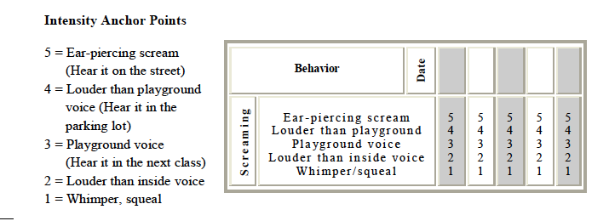
Monitor Intensity

Slide 107
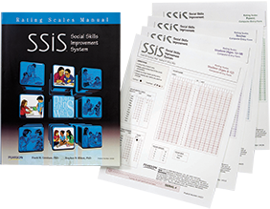
Screening / Progress Monitoring Tools
Trends: Systematic Screening for Behavior Disorders, 2nd Edition (SSBD) K-6
Social Skills Improvement System (SSRS Gresham & Elliot)
BASC™-2 Behavioral and Emotional Screening System

Slide 108
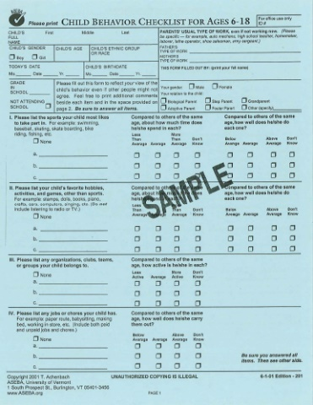
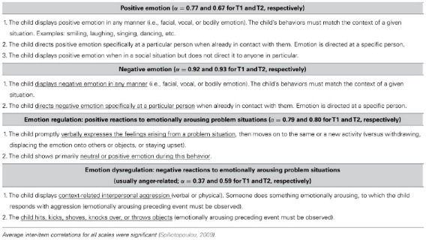
Screening / Progress Monitoring Tools
Child Behavior Checklist (CBCL)
Minnesota Preschool Affect Checklist Revised /Shortened
Ages & Stages Social Emotional (ASQ-SE

Slide 109
Discussion
Which indicators are in place? Not in place?
What factors contribute to your school or district’s existing implementation efforts for Tier 1, universal prevention systems?
Do you need to consider participation in other phases of SW-PBIS?

Slide 110
Action Planning
Complete the Tier II Readiness Checklist
Complete Tier I and II of the Tiered Fidelity Inventory (TFI)
Write action plan steps according to identified needs

Slide 111
References
Crone, D.A., Hawken, L. S. & Horner, R. H. (2010). Responding to problem behavior in schools the behavior education program (2nd ed.). New York: The Guilford Press.

Slide 112
education.ohio.gov

